Slide 1
Codename – ‘MadDog’ Introduction
VMM Trap Framework

Slide 2
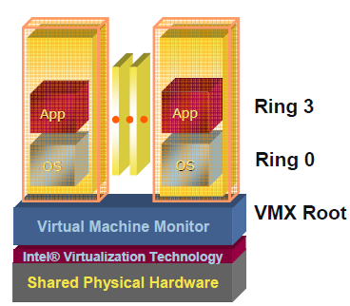
What is VT

Slide 3
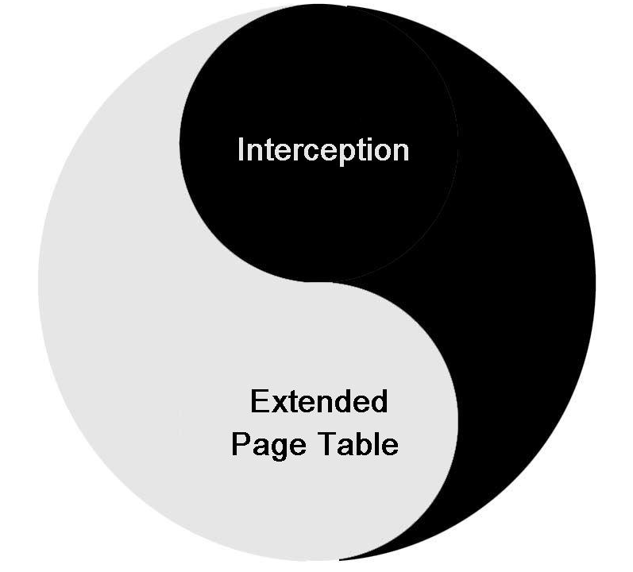
What is VT

Slide 4
MadDog Features
Deeper Hide
Dynamic Load and Unload After OS is On
Flexible But Easy To Use
Support Intel™ VMX

Slide 5
Demo 1

Slide 6
Hide Deeper
VMM Level Hide
  Hide At “Ring -1”
  Won’t affect OS & 3rd-Party Software Integrity once install
  Can affect all software’s functionality

Slide 7
Dynamic Load & Unload
Load & Unload at OS Runtime
  Easy to install
  Easy to debug/test

Slide 8
Future
Support Page-Faking Tech.
Support AMD™ SVM Tech.
Migrate to EFI Platform
Build a Software Protection Model

